Slide 1
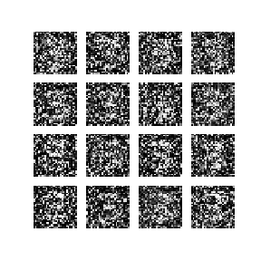
Developing a 2D Deep Convolutional GAN for Gray Scale and RGB Images
Week 5: (02/25/2022)
Week Lead: Christian Zamiela

Slide 2
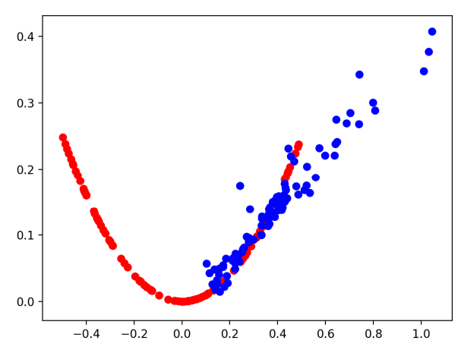
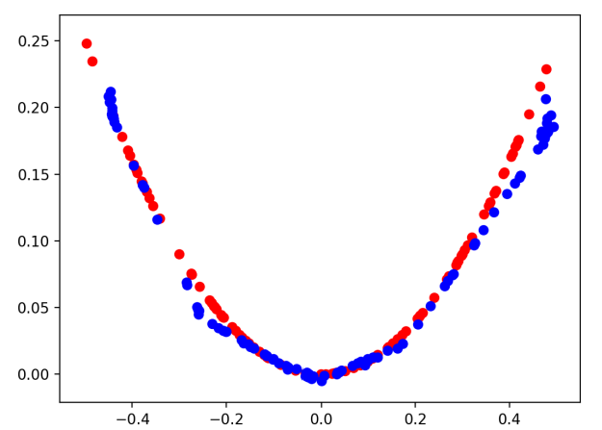
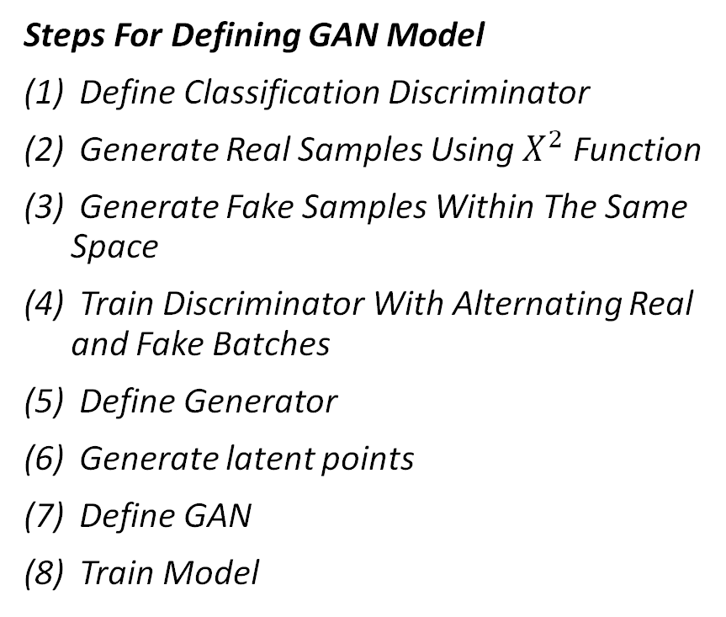
Review: Training a 1D GAN
The simplest and most effective method of combining these tow models is by defining a parent model that encapsulates both the generator and discriminator
This is not an entirely new model; it is rather a combination of the two models we have just defined…
The discriminator only cares if images or real or fake, so generator is not needed to train discriminator
The generator only cares about the performance of the discriminator about the fake images
Steps For Defining GAN Model
Define Classification Discriminator
Generate Real Samples Using $X^{2}$Function
Generate Fake Samples Within The Same Space
Train Discriminator With Alternating Real and Fake Batches
Define Generator
Generate latent points
Define GAN
Train Model

Slide 3
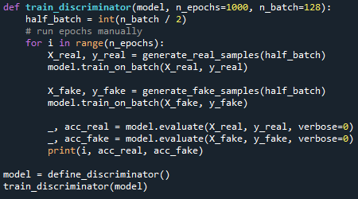
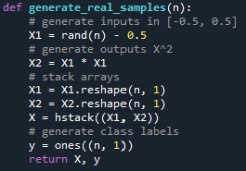
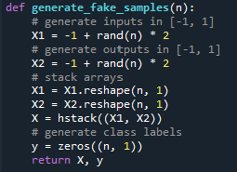
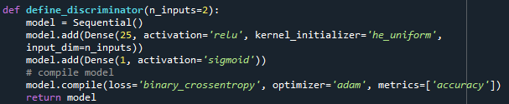
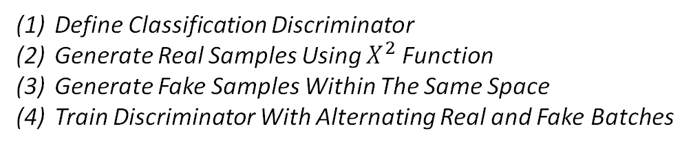
Review: Training a 1D Discriminator
Define Classification Discriminator
Generate Real Samples Using $X^{2}$Function
Generate Fake Samples Within The Same Space
Train Discriminator With Alternating Real and Fake Batches
Important: Adjusting our x values to generate the “Fake” training samples, and then training the Discriminator on both the real and fake images, updating and model after each iteration.
(4)
(2)
(3)
(1)

Slide 4
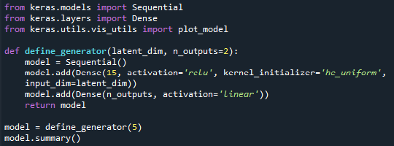
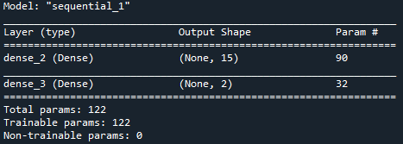
Review: Defining a 1D Generator Model
(5)
NOTES:
We do not compile the generator model like we compiled the discriminator
The Generator model, unlike the discriminator is not fit directly
We parameterize the input dimensions so we can adjust
Two outputs (x,y)
Notes:
Preston

Slide 5
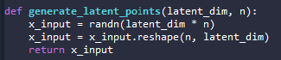
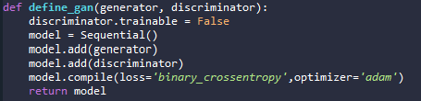
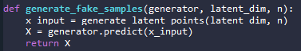
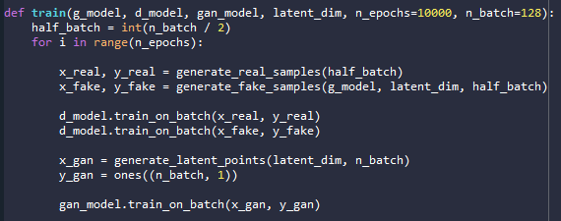
Review: Generate Latent Points, Define GAN, Train Model
(6) We can generate the “latent points” that will act as input for the Generator
(7) Define GAN by combining generator than discriminator in sequential model.
(8) Train Model: Similar to training discriminator.
(6)
(7)
(from step 5)
(8)
Notes:
Durant

Slide 6
Training a 2D GAN
Steps For Defining GAN Model
Define Classification Discriminator
Generate Real Samples Using From MNIST and CIFAR-10.
Generate Fake Samples Within The Same Space
Train Discriminator With Alternating Real and Fake Batches
Define Generator
Generate latent points
Define GAN
Train Model
Author choose to use MNIST and CIFAR-10 dataset because the datasets are well known, and images are small.
We can focus on the discriminator and generator architecture for image data.
Objectives
How to define and train the standalone discriminator model for learning the difference between real and fake images.
How to define the standalone generator model and train the composite generator and discriminator model.
How to evaluate the performance of the GAN and use the final standalone generator model to generate new images.

Slide 7
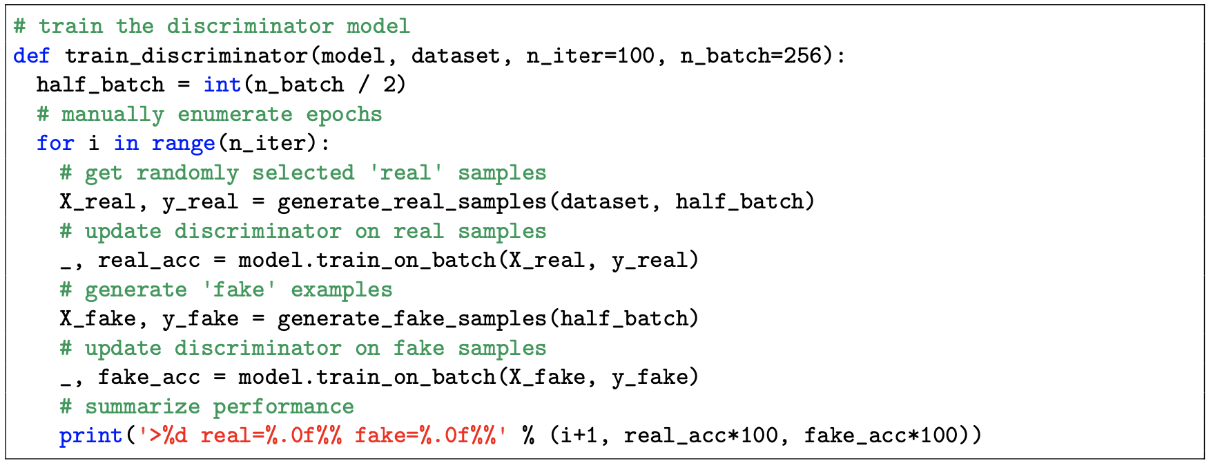
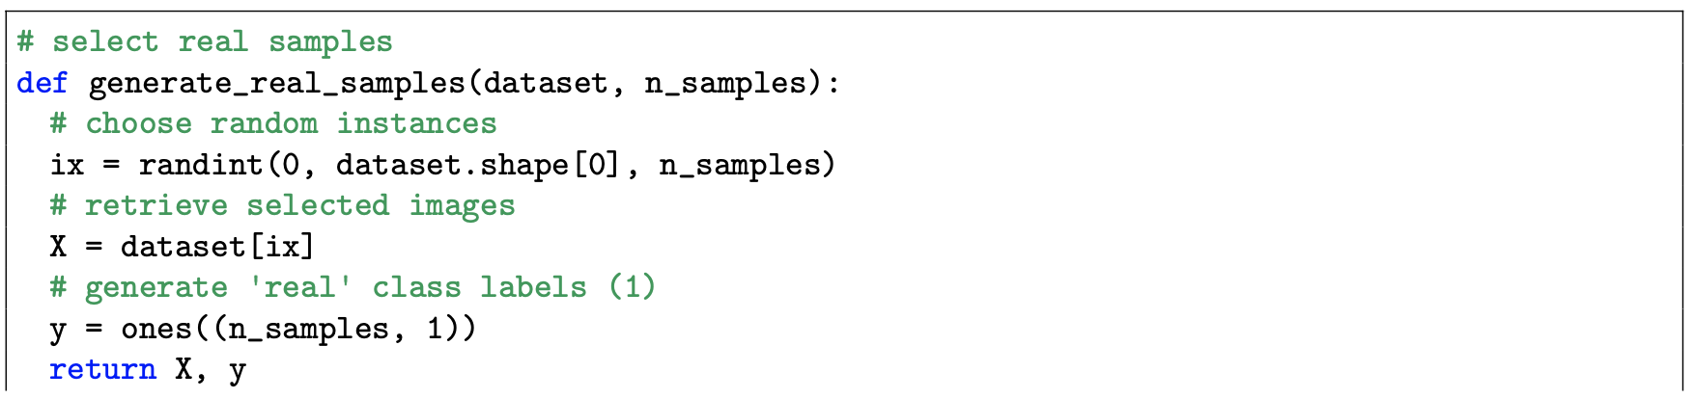
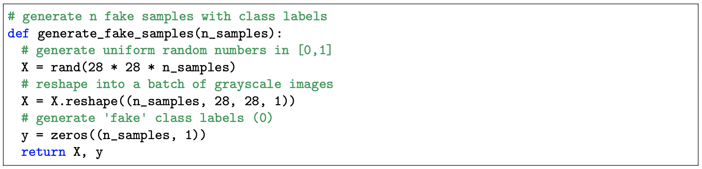
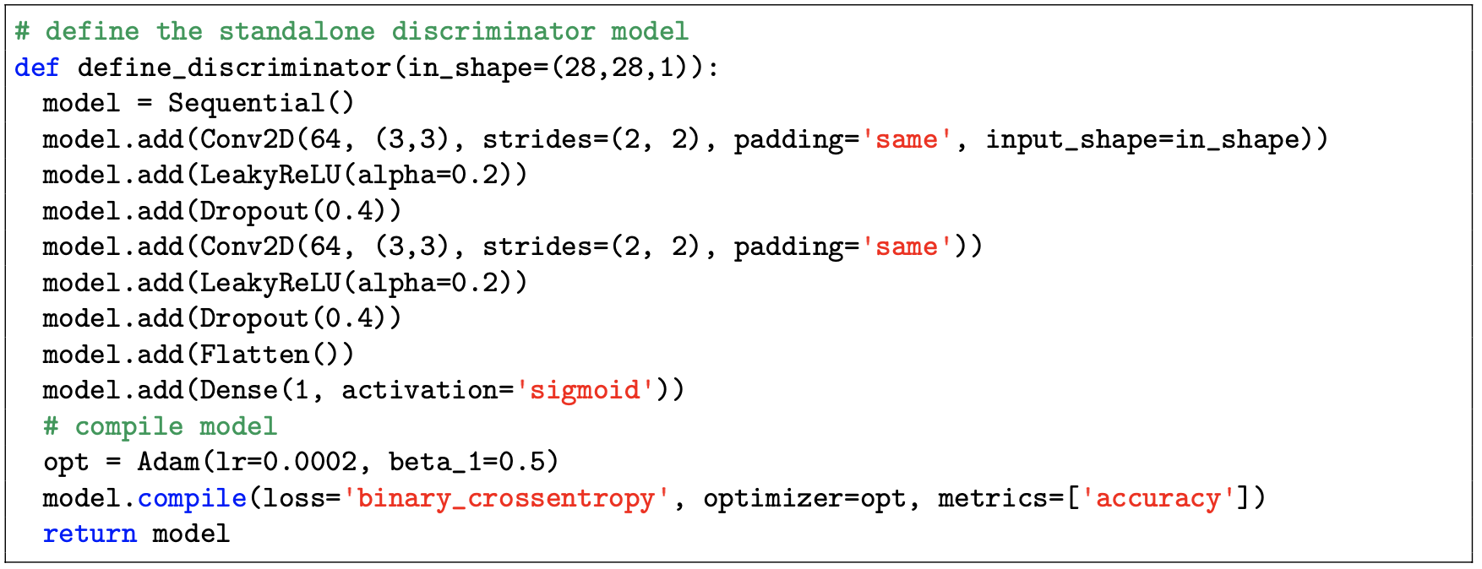
Training a 2D Discriminator
Define Classification Discriminator
Generate Real Samples Using From MNIST and CIFAR-10.
Generate Fake Samples Within The Same Space
Train Discriminator With Alternating Real and Fake Batches
(2)
(3)
(4)
Changed for dimensions of random numbers generated to (32,32,3)
Key Points:
Generating real and fake samples code is the same as 1D. Pulling information from image dataset
Discriminator contains convolutional layers, leaky relu, and dropout layers for image processing
Discriminator is exporting real and fake sample prediction accuracy.
Changed for dimensions of input to (32,32,3) for RGB Images
(1)
Depth of the network increase for RGB Images because of higher resolution

Slide 8
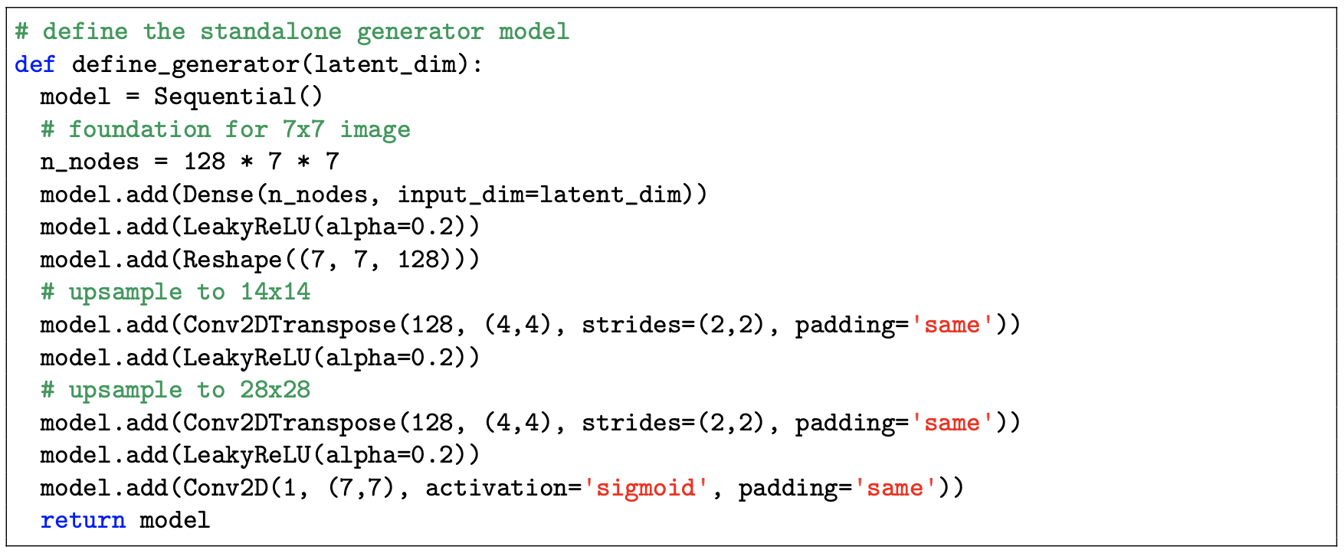
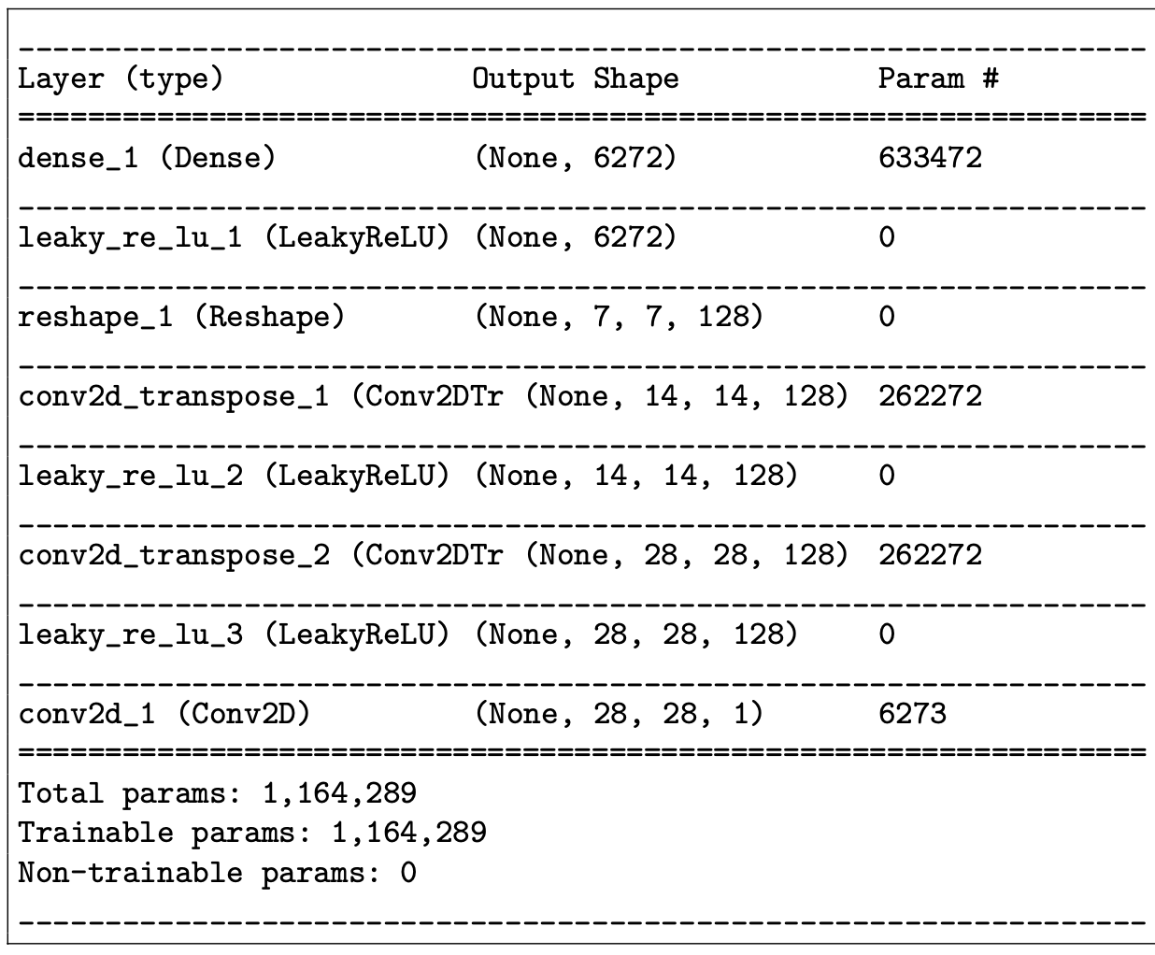
Defining a 2D Generator Model
Key Points:
Number of nodes is dependent on the size of image and dimensions of the last convolutional layer in discriminator.
Convolutional transpose layers are used to up sample images to the same size as real input images.
Single neuron in the output is different than two neurons in the 1D model.
Model is not compiled
(5)
Dimensions of the last convolutional layer output of the discriminator. Changes to (256, 4, 4) for RGB images

Slide 9
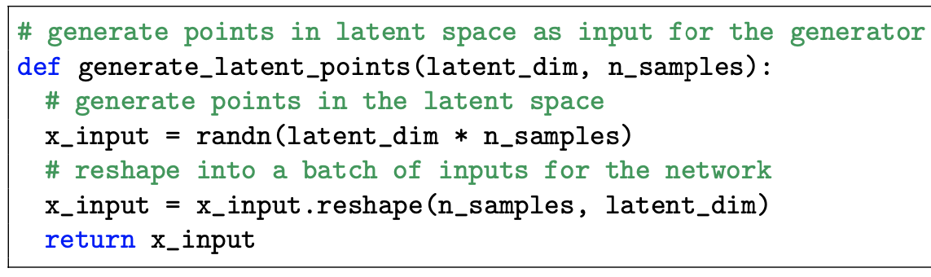
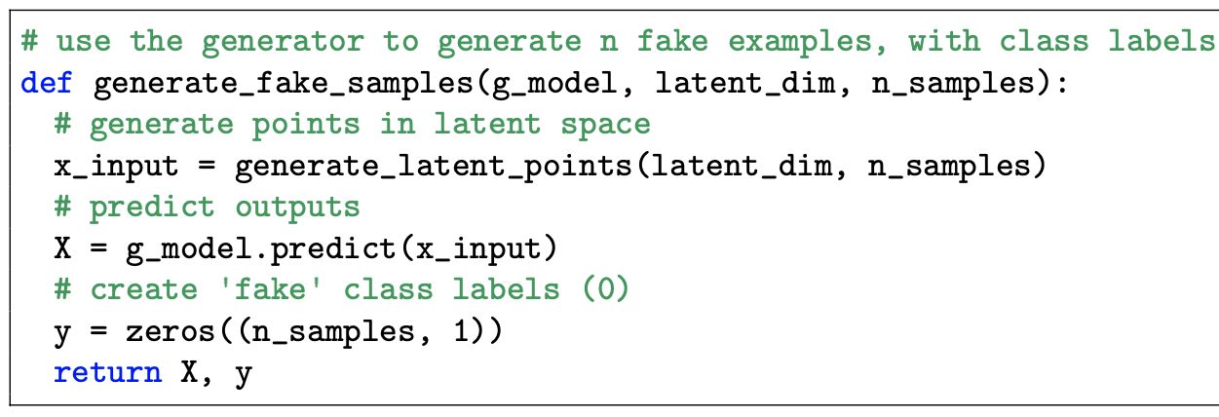
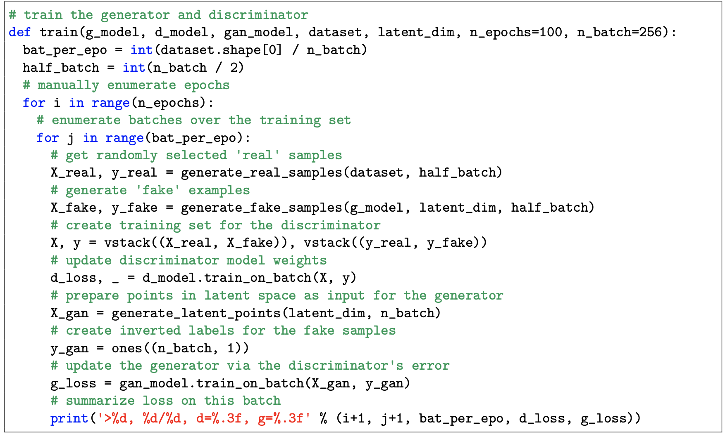
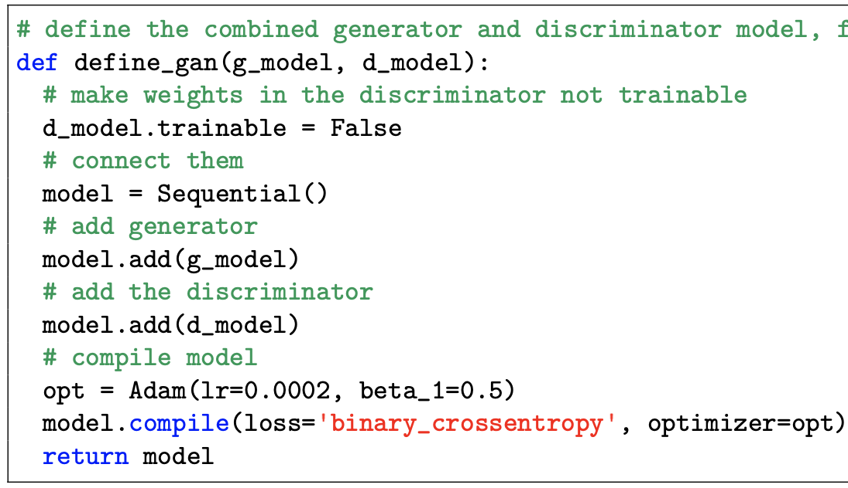
Generate Latent Points, Define Gan, Train Model
(6) We can generate the “latent points” that will act as input for the Generator
(7) Define GAN by combining generator than discriminator in sequential model.
(8) Train Model: Learning real and fake sample in batches
(6)
(8)
(7)

Slide 10
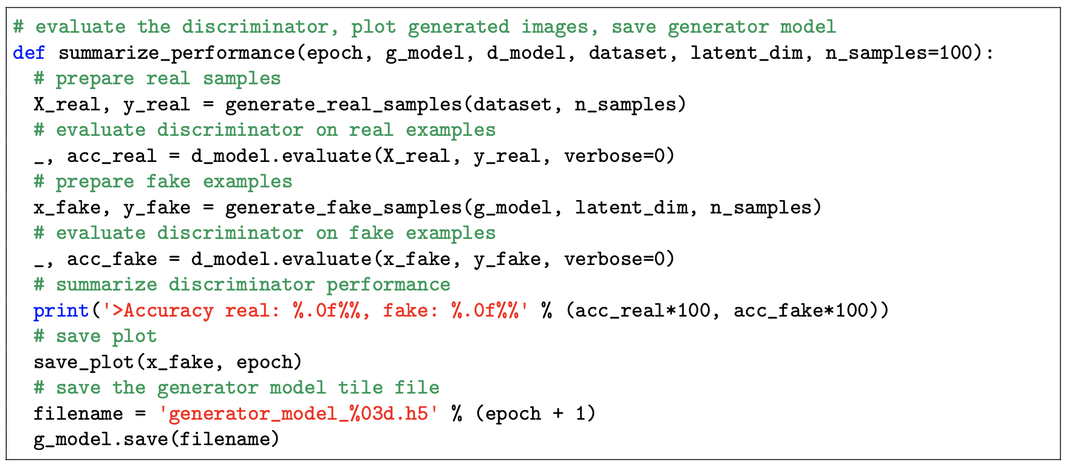
Evaluate Performance
Generally speaking, there are really very few objective ways of evaluating the performance of a GAN…
For GANS, generating synthetic images has both a subjective and objective importance. Images have to look real as well as fool the discriminator. Traditionally, the appearance of the generated image is a good evaluation of the performance of the model.
The Objective of the Generator is to cause the discriminator to only be able to achieve a classification score of about 50% accuracy when predicting real from fake examples

Slide 11
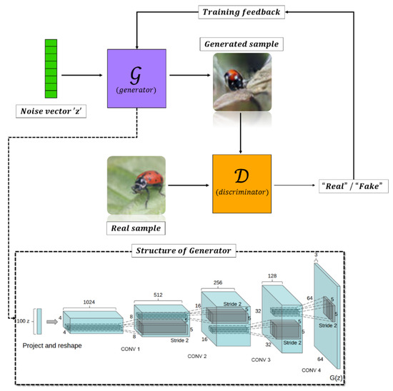
Key Takeaways
The architecture of 1D and 2D GANS are very similar with minor changes to inputs dimensions and types of layers.
The discriminator is compiled twice resulting in being trained twice every iteration.
We define a parent model that combines the generator and discriminator.

Slide 12
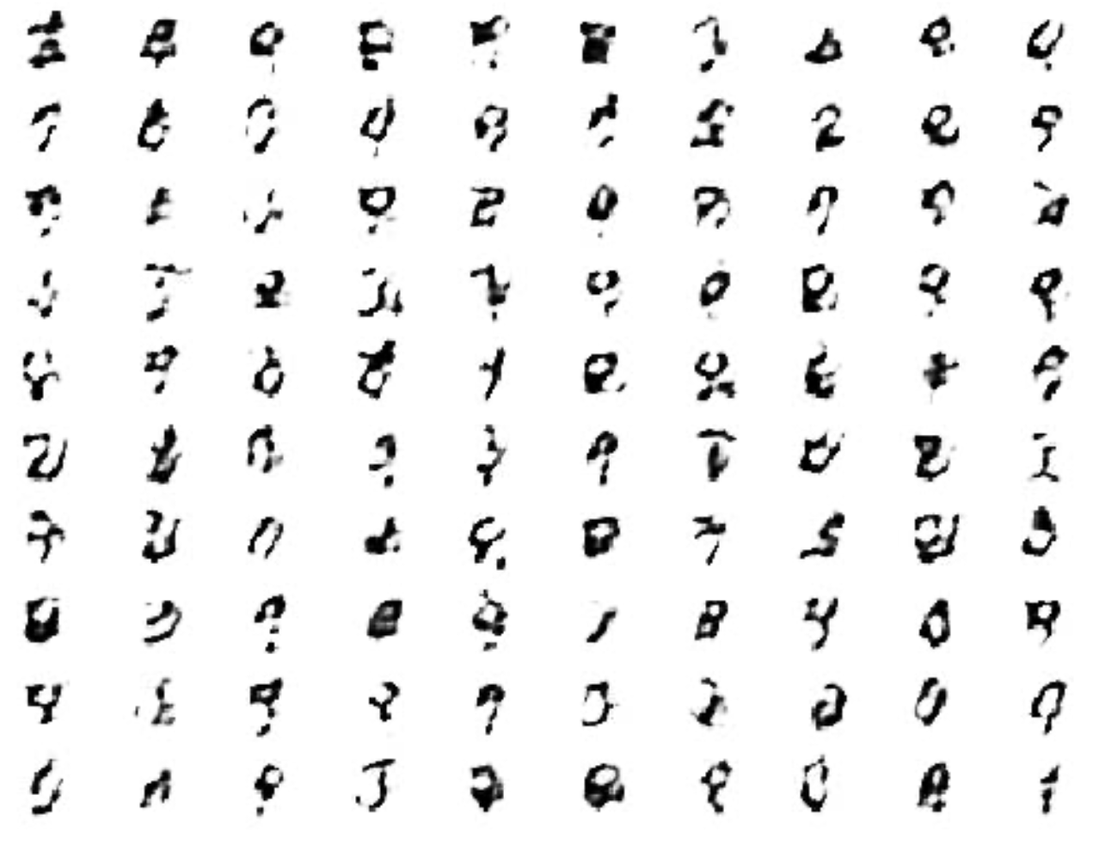
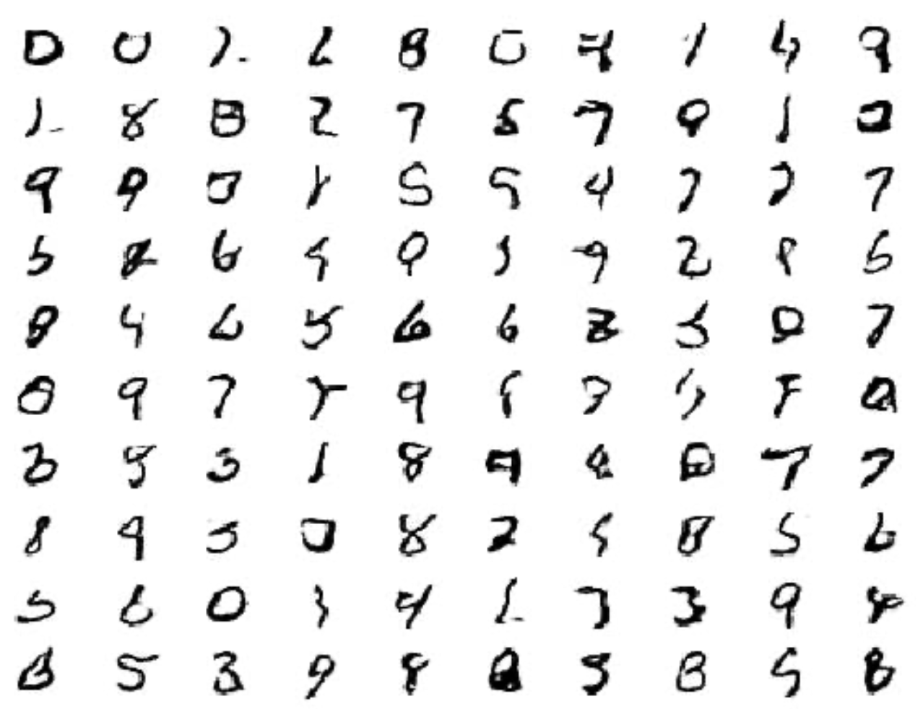
Evaluating MNIST (28, 28, 1) Resolution Images
10 epochs
100 epochs

Slide 13
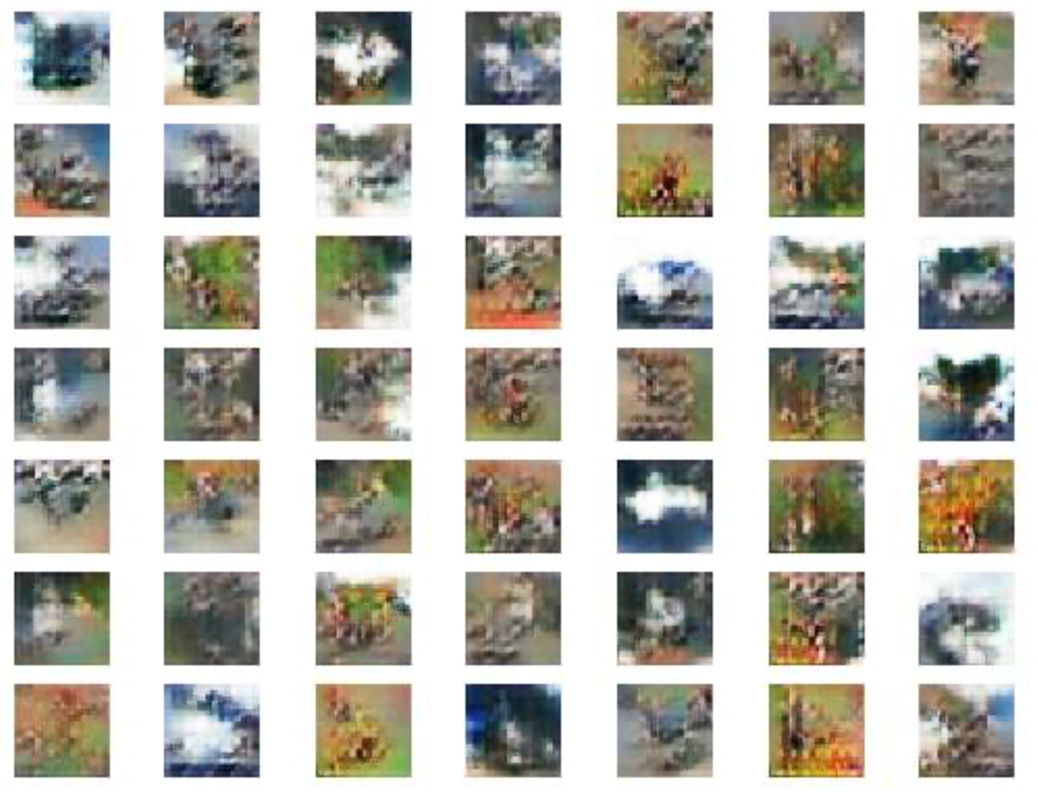
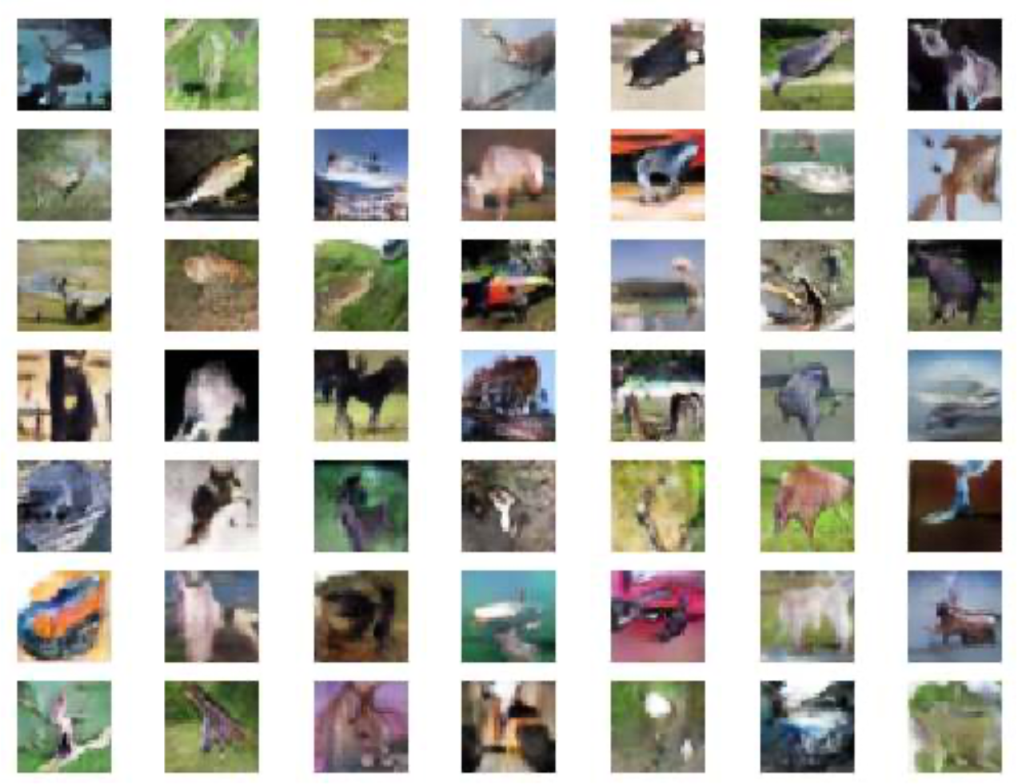
Evaluating CIFAR-10 (32, 32, 3) Resolution Images
10 epochs
100 epochs

Slide 14
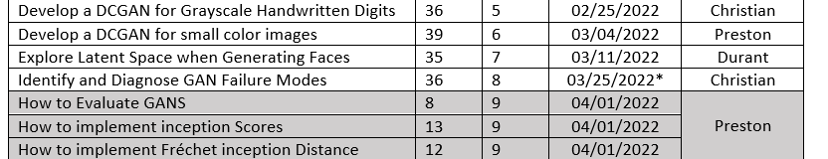
Next Week
A change to the schedule:

Slide 15
Questions
What is the stopping criteria? How is implemented?
E-day. Discuss ML instead of Quality control
Keep it high level.
Do a kahoot/quiz, for winning you get a prize.
”Get swag from Dr. Reeves”

Slide 16
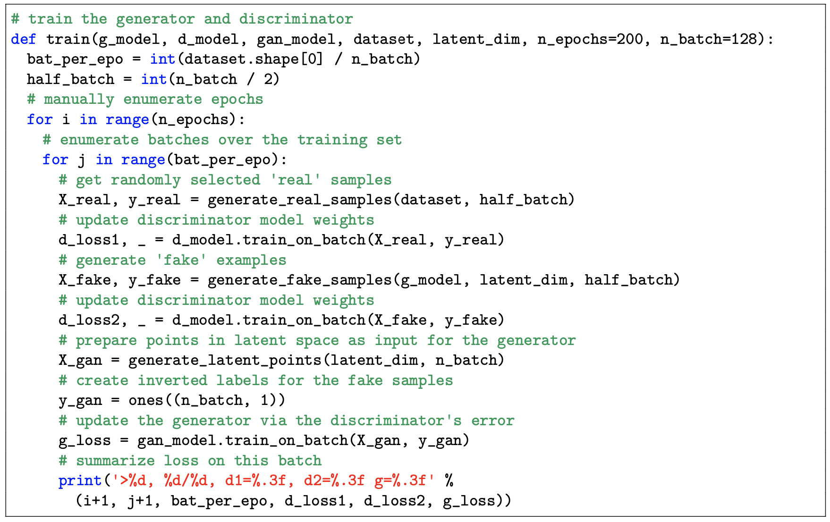
Generate Latent Points, Define Gan, Train Model

